Slide 1

The Rise of AI (DHS 2019)
-Aakash Verma

Slide 2

About me
Aakash Verma
Joined FORD as an FCG in 2012
Have worked in Manufacturing, Research and Innovation
Completed my PG Diploma in ML from IIIT-Bangalore (UpGrad) last year.
Currently pursuing my M.Tech in Data Science from BITS Pilani.
Got a chance to lecture Research students from various college at PSG College of Tech.
Currently part of GDIA Tech developing a Platform that can help ford employees create and deploy ML models faster.

Slide 3
Agenda for Today
Niramai – Using Tech to save lives
Morphing images using Deep Generative Models (GANs)

Slide 4
Expectations?
DHS 2019
Learning vs Awareness

Slide 5
NIRAMAI
DHS Presenter: Dr. Geetha Manjunath
Slides courtesy: Niramai

Slide 6
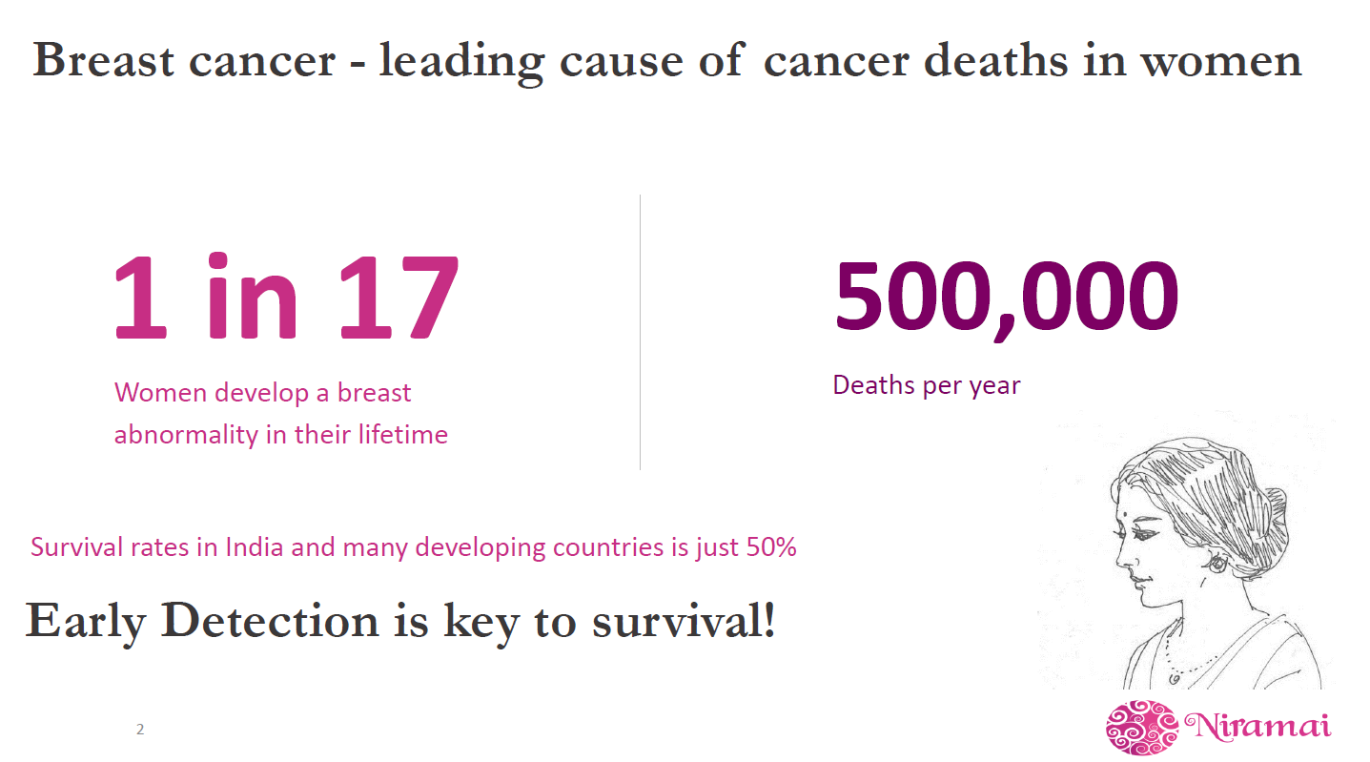
Niramai – Using Technology to save lives

Slide 7
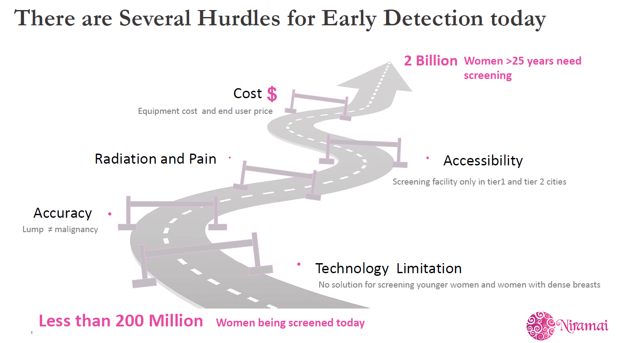

Slide 8
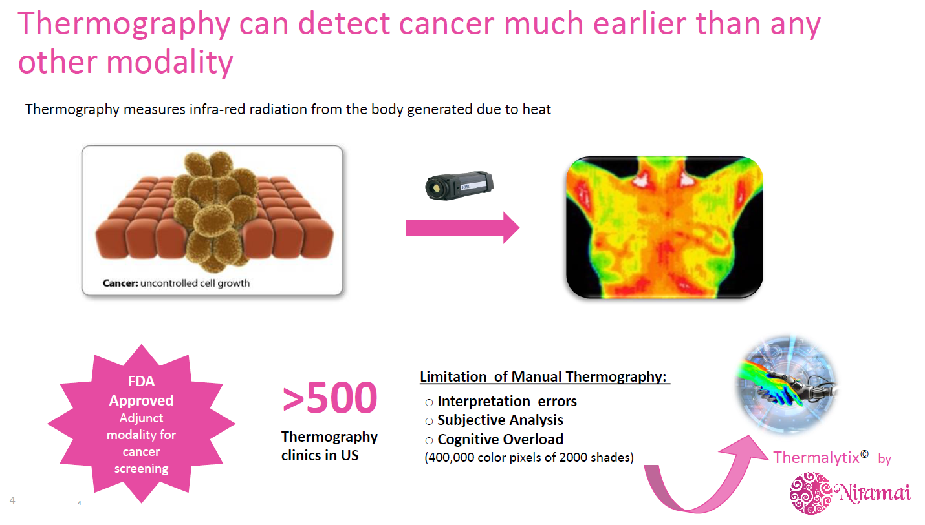

Slide 9
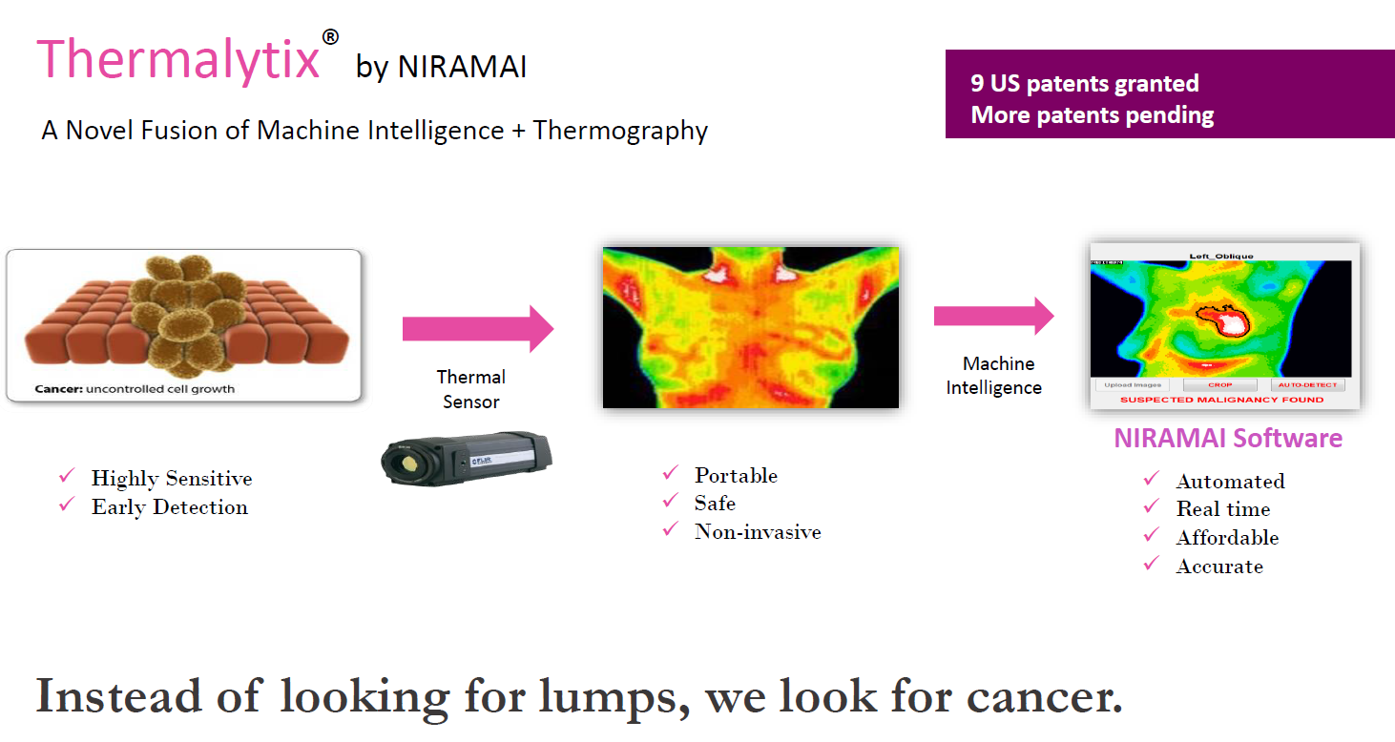

Slide 10
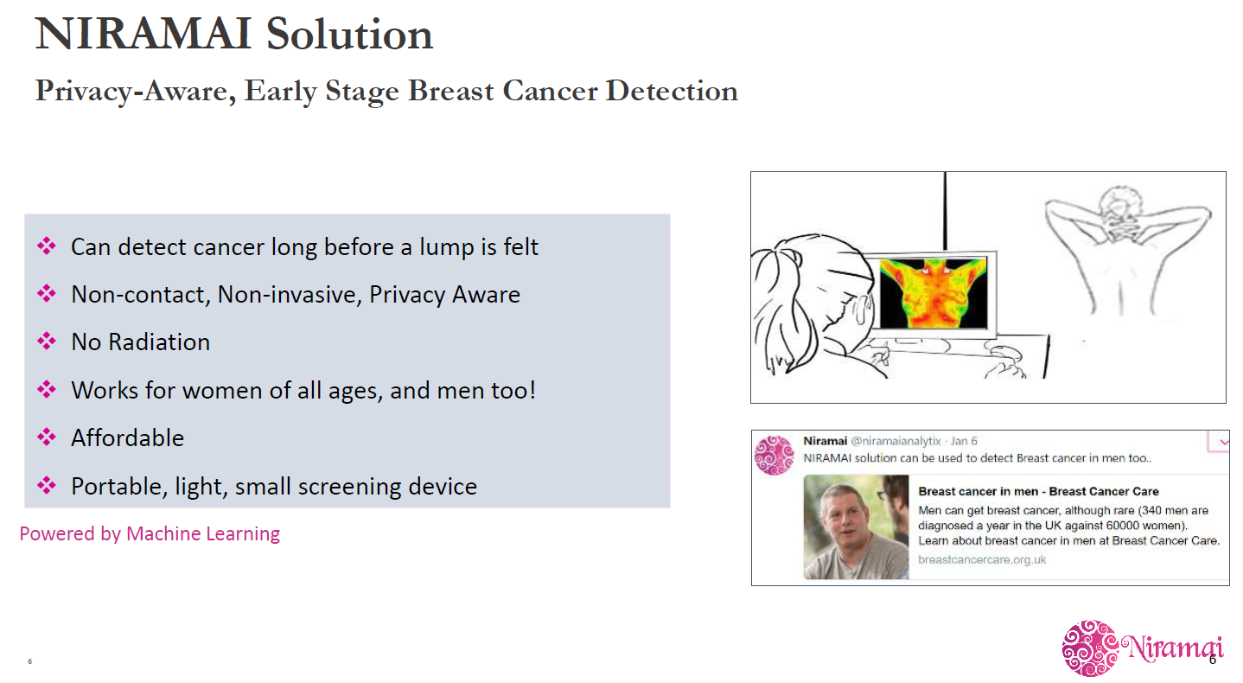

Slide 11
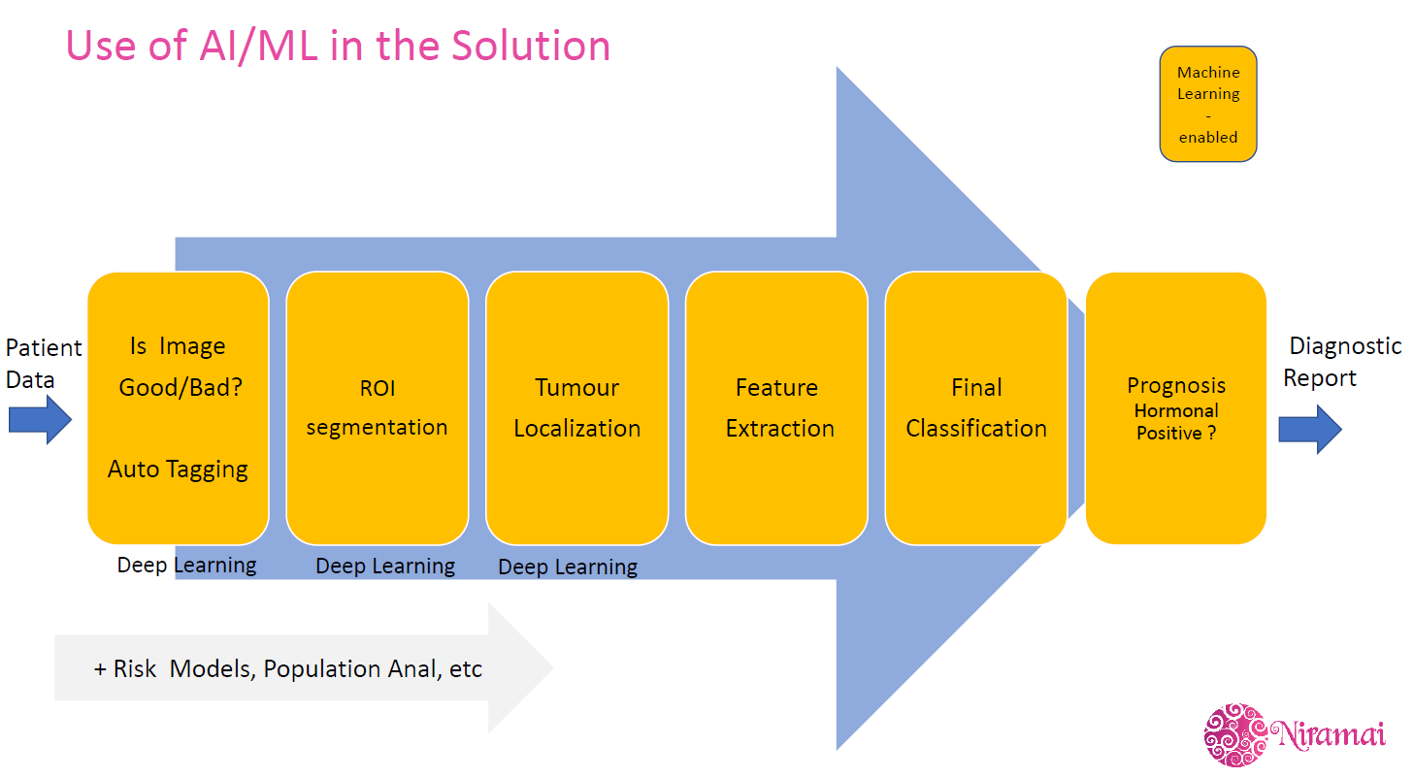

Slide 12
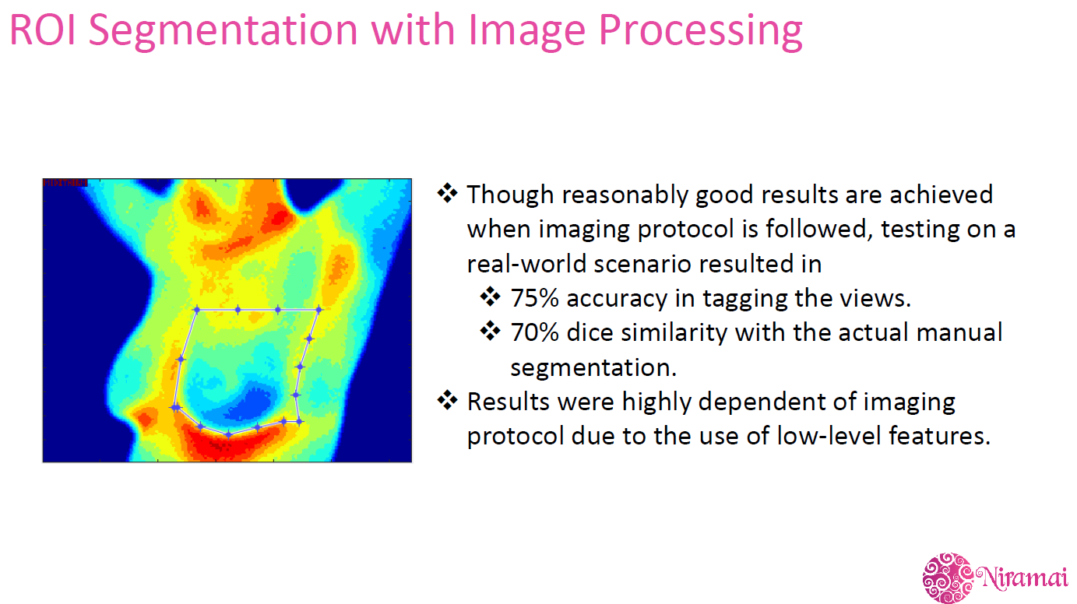

Slide 13
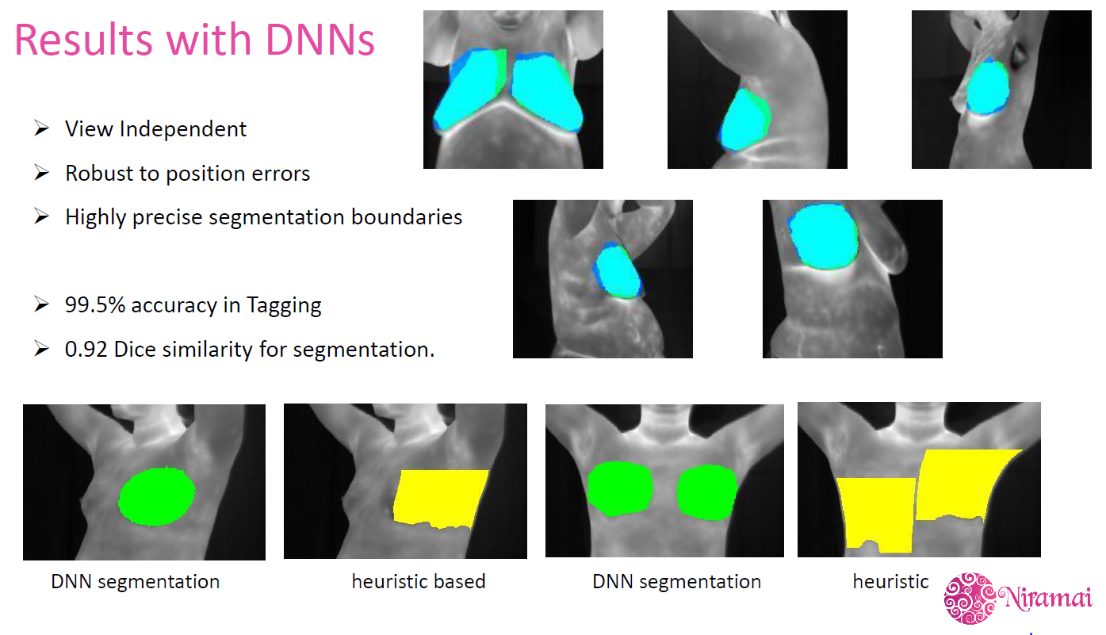

Slide 14
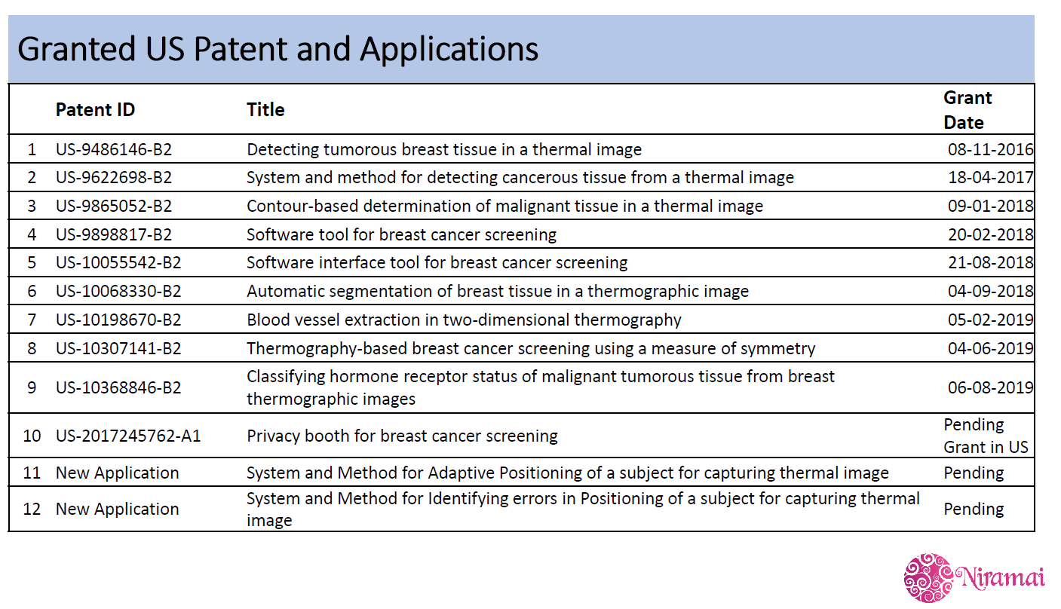

Slide 15
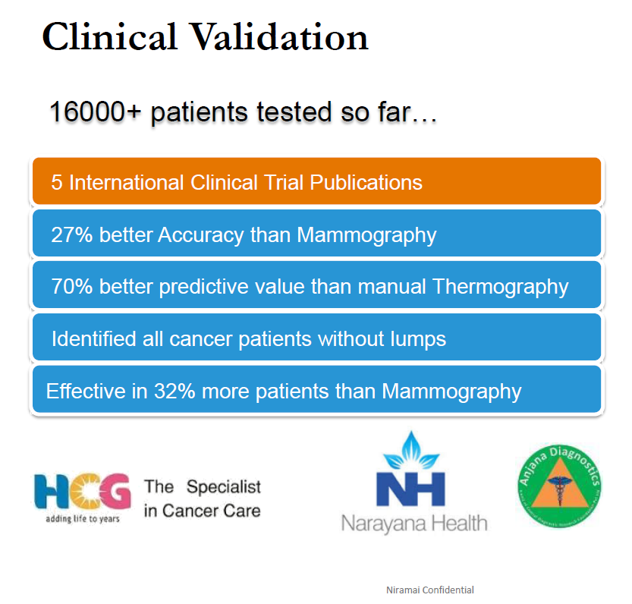

Slide 16
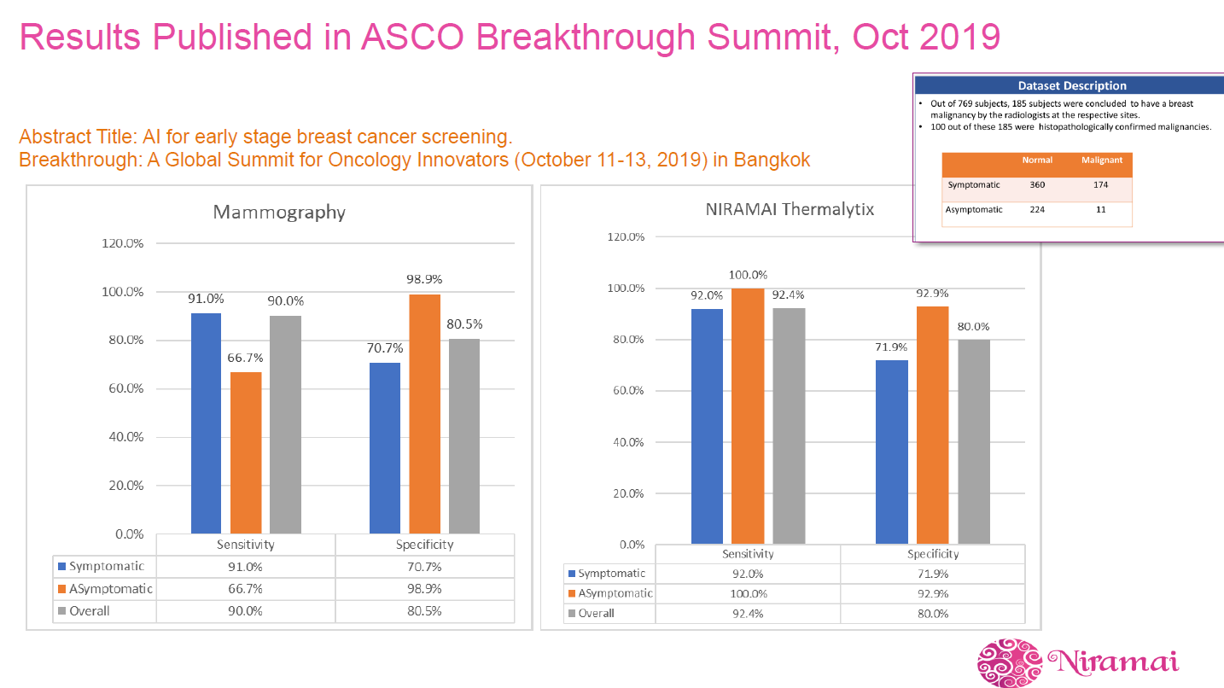

Slide 17
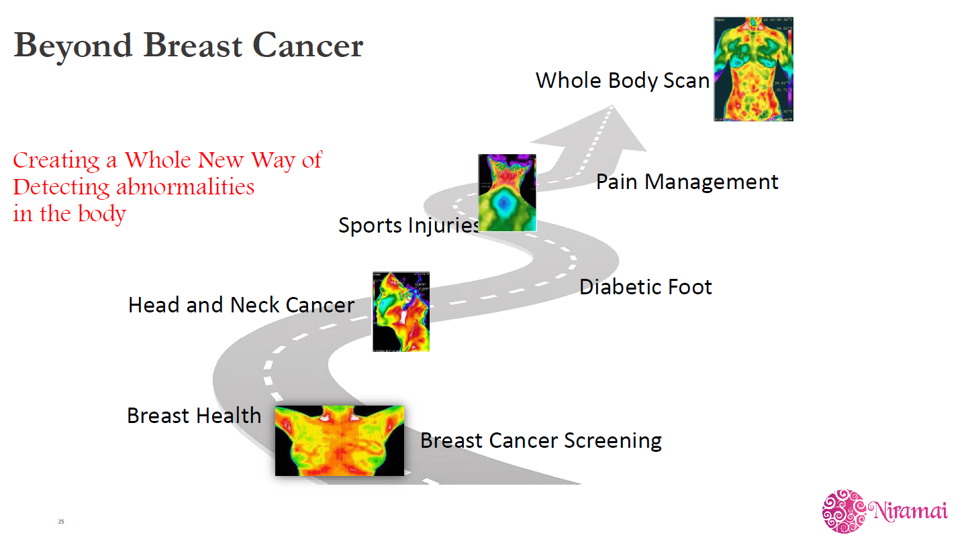

Slide 18
Morphing images using Deep Generative Models (GANs)
DHS Presenter and Slidesby : Xander Steenbrugge

Slide 19
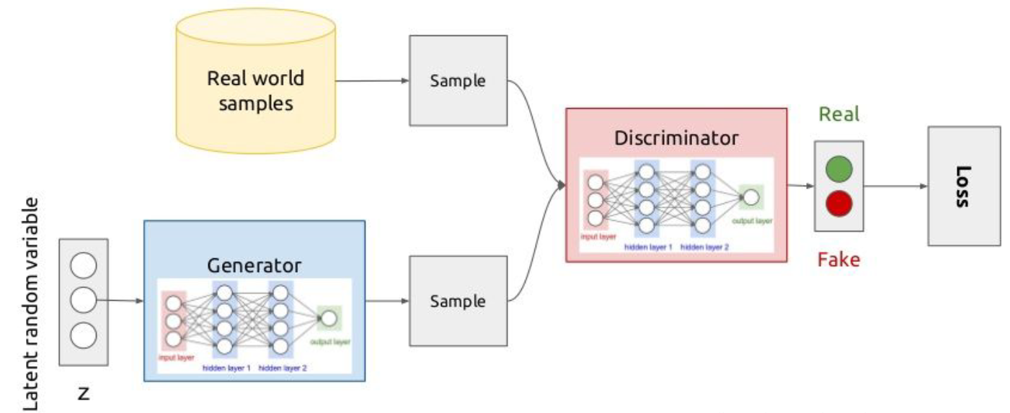
GANs

Slide 20
StyleGANs
By Nvidia
Tries to replace the random latent space of traditional GANs with something that is more structured.
This structure is learned during the adversarial training process.

Slide 21
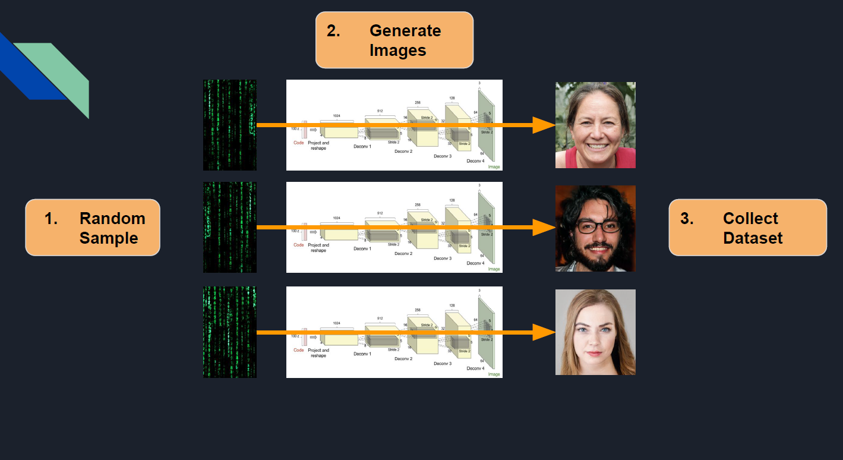
Process

Slide 22
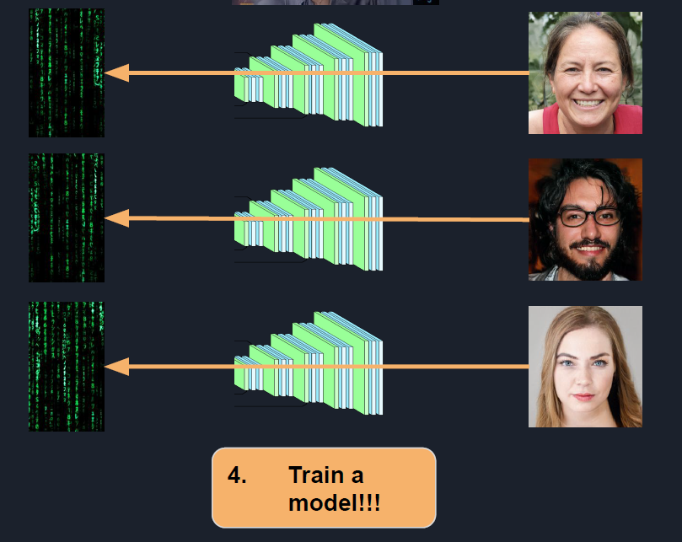

Slide 23
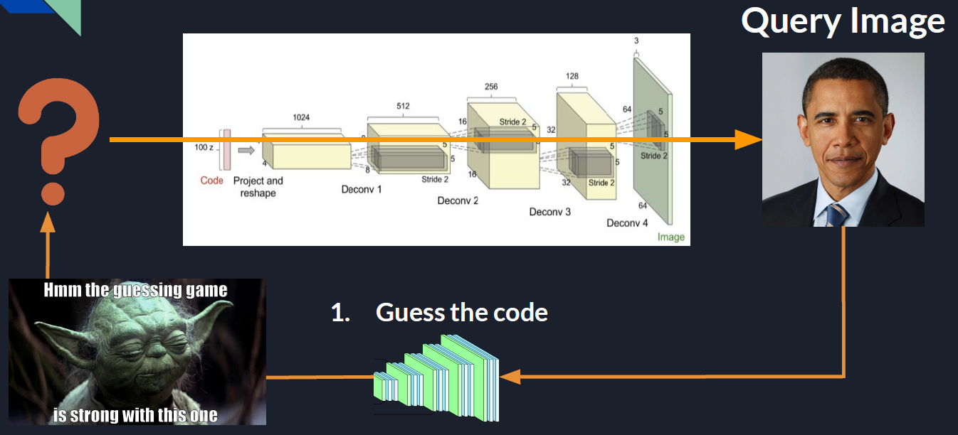

Slide 24
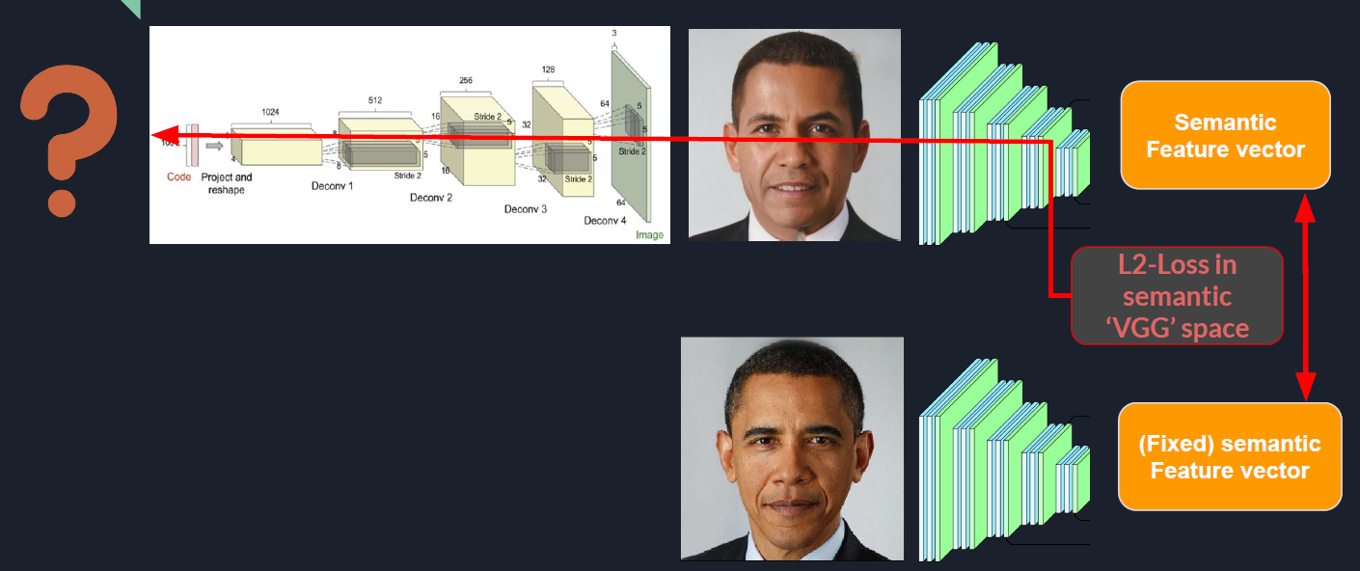

Slide 25
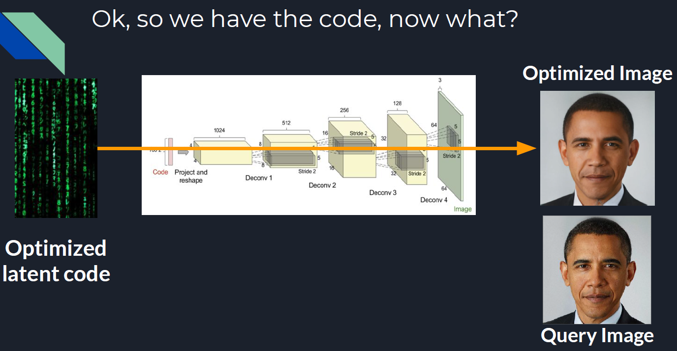

Slide 26
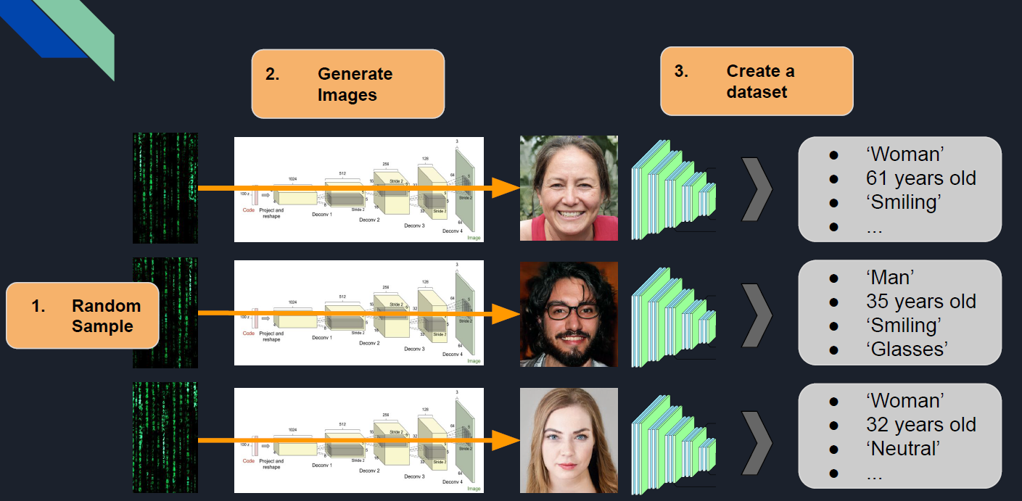

Slide 27
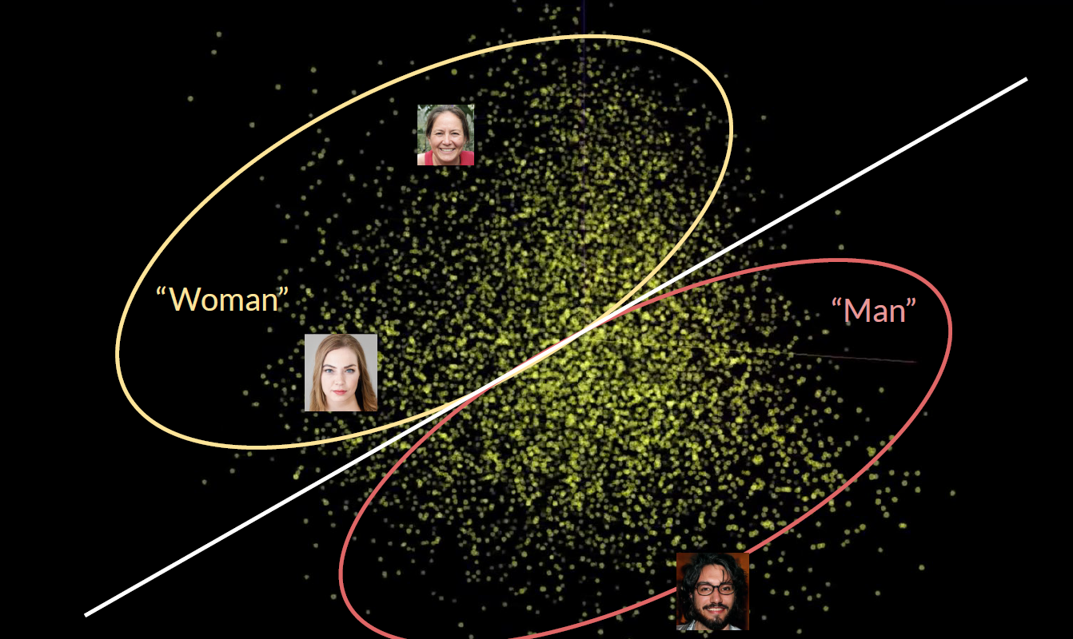
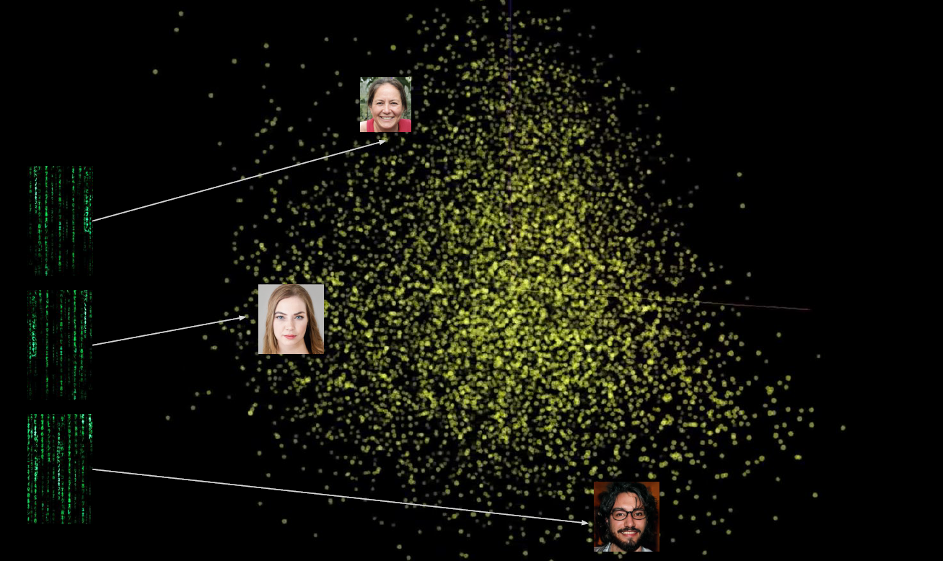
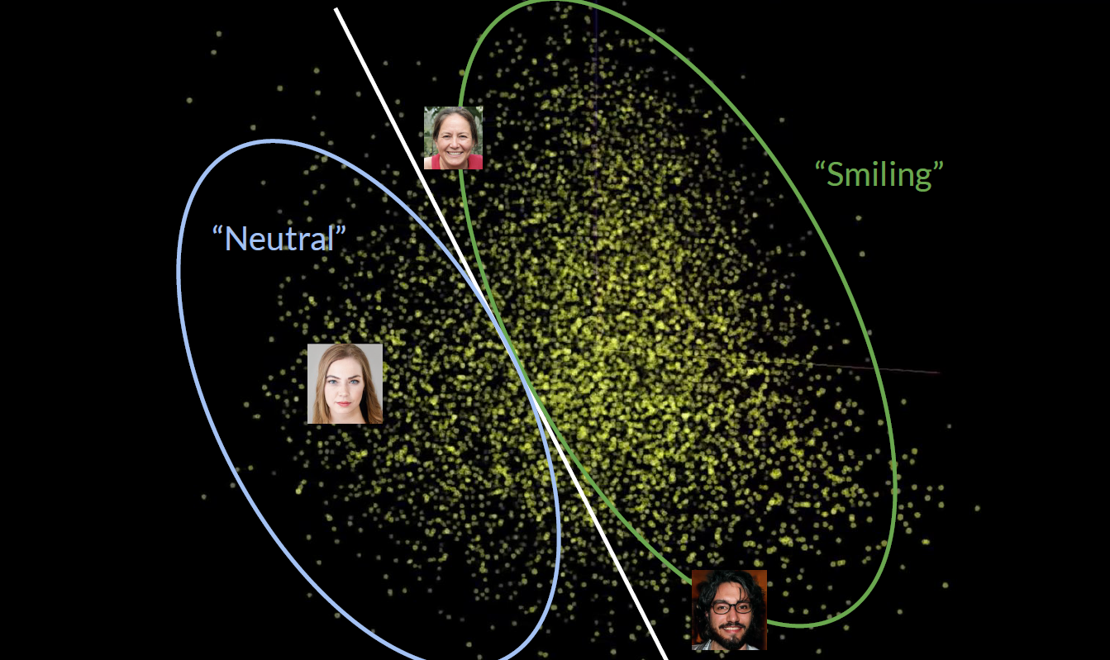

Slide 28
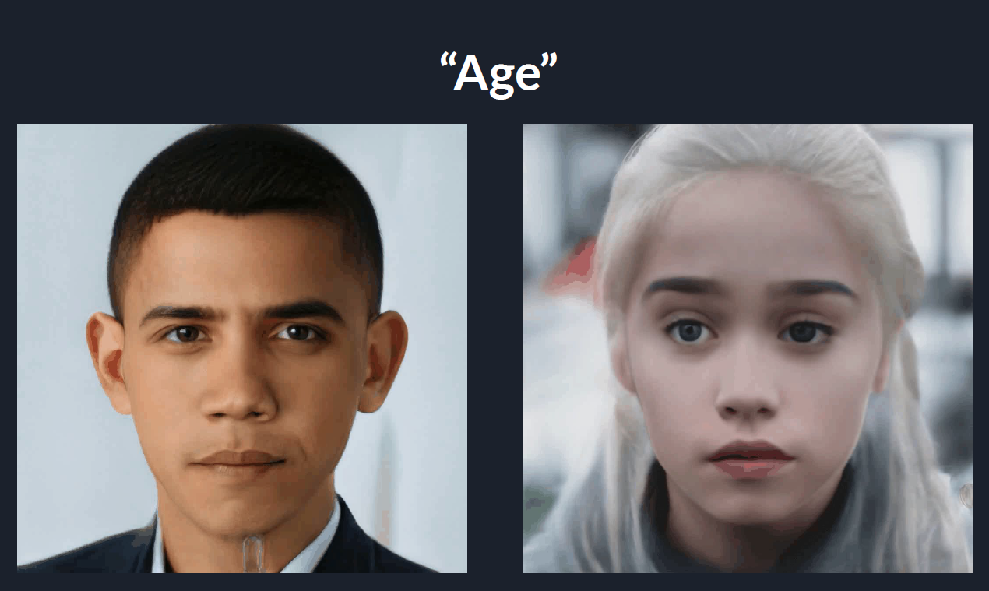

Slide 29
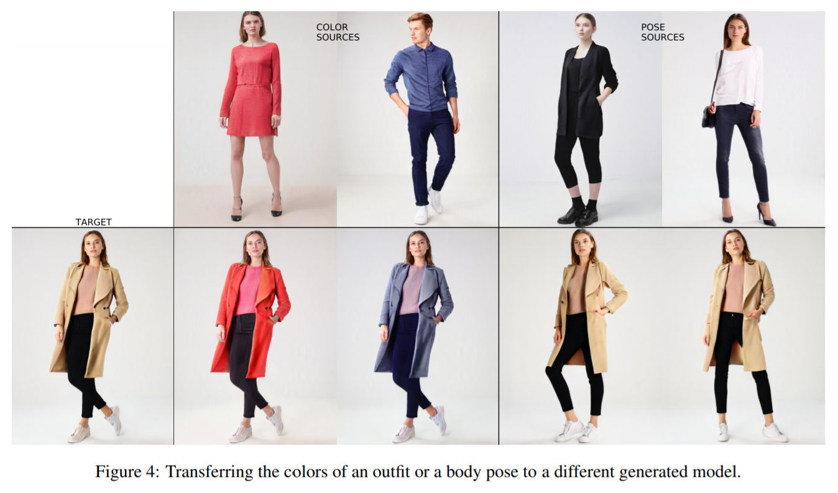

Slide 30
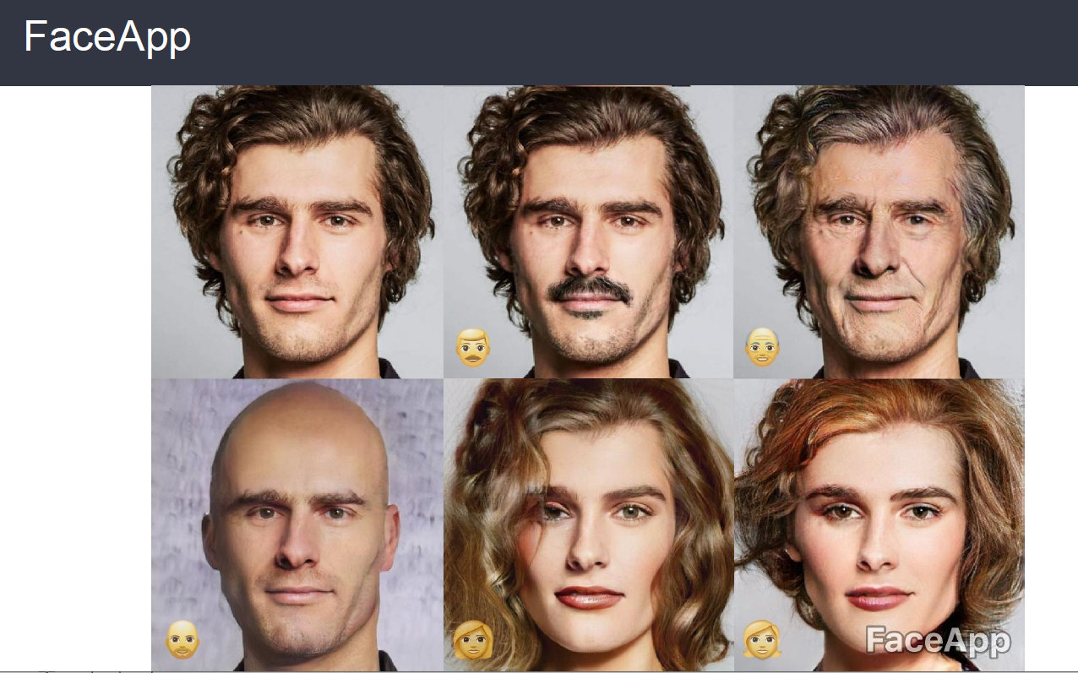

Slide 31
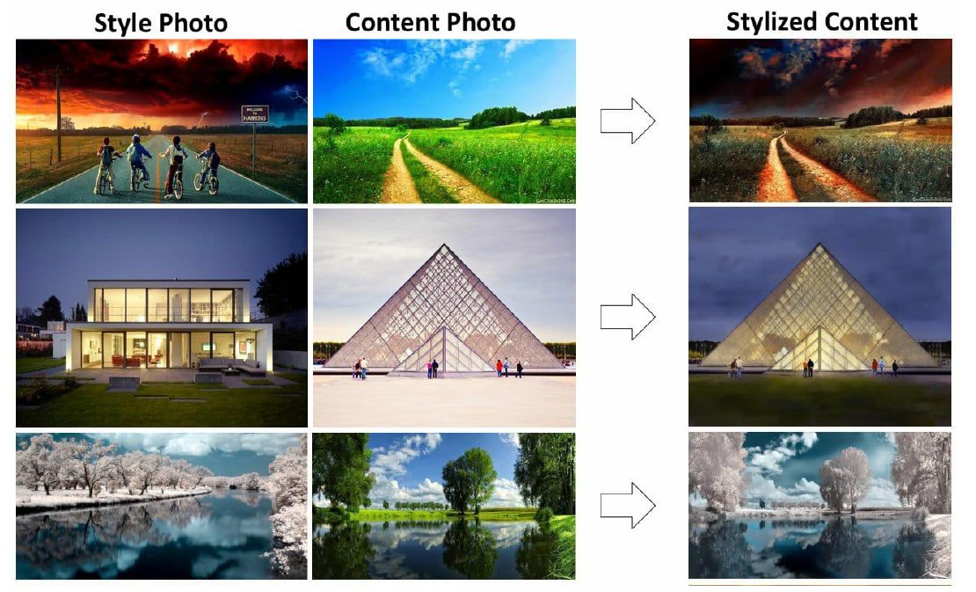

Slide 32
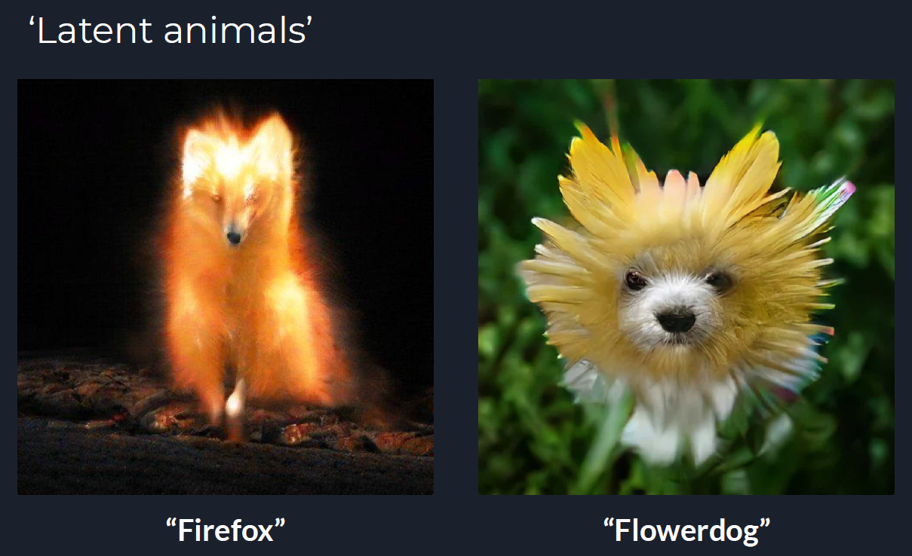

Slide 33
Thank you!
CDSID: vaakash
GitHub: https://github.com/Vaakash89

